Slide 1
Mayhem Heroes Crash Course
Alex Brewer, Technical Solutions Engineer
April 23rd, 2022
ASU Hackathon

Slide 2
Agenda
Mission
Fuzzing Introduction ~45 mins
Mayhem Setup
Fuzzing Lighttpd
Fuzzing Overview and Fuzz Targets
Getting Help ~10 mins
Community and Discord
Mayhem CLI ~15 mins
Packaging for Mayhem ~30 mins
Docker overview
Docker + Mayhem Exercise
Build Systems ~30 mins
Common Patterns
CMake Exercise
~Break (30 mins)~
OSS Fuzzers ~30 mins
libFuzzer Example
libFuzzer Exercise
GitHub Actions ~30 mins
Case Study ~20 mins
Cista Overview
Conclusions ~10 mins
Training Survey
Mayhem Heroes ~10 mins
Survey and Conclusion ~10 mins
Total Time: 4 hrs (+ 2hrs for Hackathon integration work)

Slide 3
After this training, you will be able to
Explain what fuzz testing is
Fuzz an application with Mayhem
Reproduce a found defect
Package a fuzz target using Docker
Build a fuzz target
Add instrumentation to a target with libFuzzer
Automate the whole process using Github Actions

Slide 4





What is
Fuzzing?
Fuzzing a target with Mayhem
1
Package a target using Docker
2
Set up build systems with CMake
3
Create a Fuzz Target (w/ libFuzzer)
4
Automate with Github Actions
5

Slide 5





Modern CI/CD Pipeline
Write Code
Run Tests
Check for failure
Build and Package
Automate

Slide 6

Modern CI/CD Pipeline
Create a Fuzz Target with libFuzzer
Fuzzing a target with Mayhem
Set up regression testing
Package a target using Docker
Automate with Github Actions

Slide 7
Mission
Notes:
Have you ever wondered how the best hackers in the world are able to find new zero day vulnerabilities that enable them to carry out attacks? (pause)
What I mean here is that people who can find vulnerabilities in something like Google Chrome that no one has ever found before, you could potentially break into an estimated 2.6 million devices.
But just about everything is software enabled today, so this issue doesn’t stop at Chrome. Software is in everything: cars, trains, DoD weapons systems.
For example, a recent exploit known as the TBONE exploit, enabled remote code execution in Tesla cars. That means the original hackers who found the vulnerability while it was unpatched could have potentially taken over thousands of vehicles.
So today, we have a software security crisis.

Slide 8



!
Fact
Worse
Result
Growing cybersecurity talent shortage
We’re shipping code faster than ever, as insecure as ever
Offense has a permanent advantage today.
570x
Developers than cybersecurity experts
87% Of application security isn’t automated today
Status quo Is not working.
GitHub, Microfocus, SANS
Notes:
First, the cybersecurity talent needed to secure the world’s software is rare.
According to GitHub there are 570x more developers than cybersecurity experts.
On top of that, we’re to shipping and deploying code faster than we can secure it. Probably because in a recent survey companies responded and said that 87% of their application security isn’t automated.
Attempts to automate it through years of research into things like static application security testing, hasn’t worked.
As a result, this has left the bad guys with a permanent advantage according to DARPA.
Right now, we’re trying to play catch up with our adversaries.
This how Mayhem came to be: how do we automate application security?
So that’s what we’re hoping you’ll help us with.

Slide 9
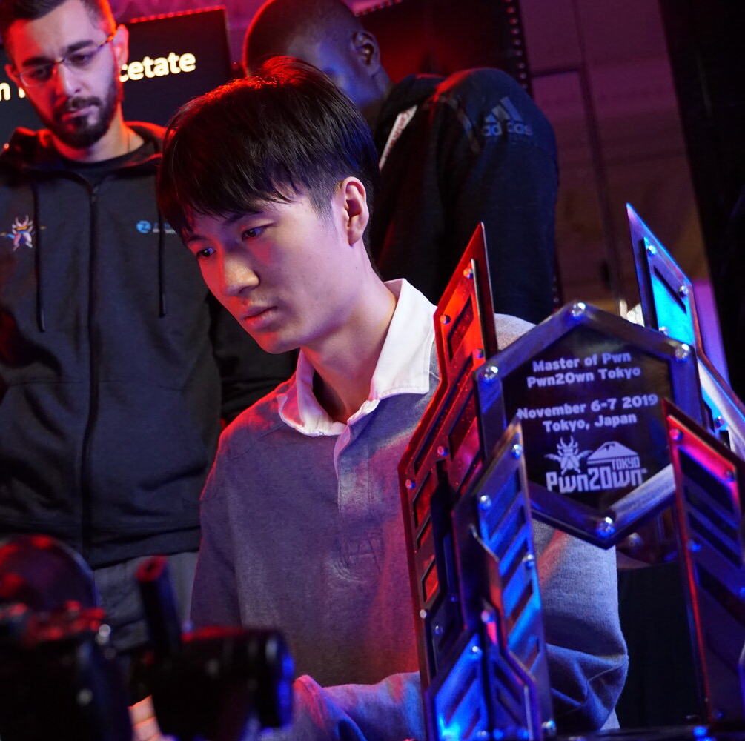
fluorescence
Richard Zhu
Image Credit: https://threatpost.com/pwn2own-tokyo-2019-amazon-echo-hackers/150033/
Notes:
Let me introduce you to one of the world’s best hackers. He goes by the name Flourescnece, though his real name is Richard Zhu.
Our CEO, Dr. Brumley, met Richard when he was 17, and recruited him to CMU. He’s found zero days in Windows, Internet Explorer, and was the first to hack a Tesla.
Fortunately for us, Richard is one of the good guys. He makes his money as part of bug bounties and contests, where he responsibly disclosing the vulnerabilities so companies can fix their software.
People like Richard are very good at what they do and if you think about it, when Richard finds a new zero day -- a new vulnerability no one but him knows about -- then for a moment in time he alone could break into 2.3 billion web-browsers. And when he finds a new zero-day in a Tesla, he alone could break into 500,000 cars.
How does he do it? If we could just automate what he does, then we would be able to finally outpace and outscale adversaries. Fluorescence and other hackers like him work much differently than how most organizations approach cyber-security. And it’s certainly not how most organizations do appsec today.
.
So that’s what we’re trying to do at ForAllSecure: automate what hackers like Richard do.

Slide 10
Vision
A world where computers automatically test and protect the world’s software from exploitable bugs at speeds and scale faster than any attacker.
Notes:
So our vision at ForAllSecure is to create a world where computers can automatically test and protect the world’s software from exploitable bugs at the speeds and scale, faster than any attacker.
And that’s what we hope you’ll help us with today by helping out open source.

Slide 11
Making It Autonomous
Suppose you managed a team of 3 humans looking for zero days
Work on the same app
Software registry w/ docker
Run the app the same way
Mayhemfile
Share work and reproduce results
Results test corpus
Focus on a particular part of app
Harnessing
Work intelligently
Advanced algorithms
Notes:
So how do we make autonomous appsec happen? Well, let’s think about what it would take to manage a team of humans like Richard looking for zero days.
They’d need to work on the same application
They’d need to run the app the same way.
They’d need to share work and reproduce each other’s results.
Focus on a particular part of the the application.
Work intelligently
Alright, but we want computers to do this for us. How do we make computers do this?

Slide 12
How do we get here?
Mayhem Advanced Fuzz Testing
Guided Fuzzing
Uses sample inputs and target feedback to generate new test cases on-the-fly:
Symbolic Execution
Models code as mathematical equations, and then solves them to come up with inputs:
↓
↑
UNIQUE INPUTS:
EXECUTION SPEED:
UNIQUE INPUTS:
EXECUTION SPEED:
↑
↓
Advanced Fuzzing
↑
UNIQUE INPUTS:
EXECUTION SPEED:
↑
Notes:
Well, in case it isn’t obvious, you use Mayhem!
Mayhem is a combination of two program analysis techniques: guided fuzzing and symbolic execution.
Guided fuzzers rely on sample inputs, or a corpus, for initial guidance to explore a program. Then, it monitors and leverages the target’s feedback to generate new, customized test cases as it runs.
Symbolic execution, models code branch conditions as mathematical equations, traverses the path, and then solves for inputs that reach that code path. The synergistic relationship between guided fuzzing and symbolic execution is referred as Advanced Fuzzing. With advanced fuzzing technologies, like Mayhem, we’re able to find vulnerabilities deep inside a program.

Slide 13
Mayhem Setup

Slide 14
What is
Fuzzing?
Fuzzing a target with Mayhem
1
Package a target using Docker
2
Set up build systems with CMake
3
Create a Fuzz Target (w/ libFuzzer)
4
Automate with Github Actions
5

Slide 15
Modern CI/CD Pipeline
Create a Fuzz Target with libFuzzer
Fuzzing a target with Mayhem
Set up regression testing
Package a target using Docker
Automate with Github Actions

Slide 16
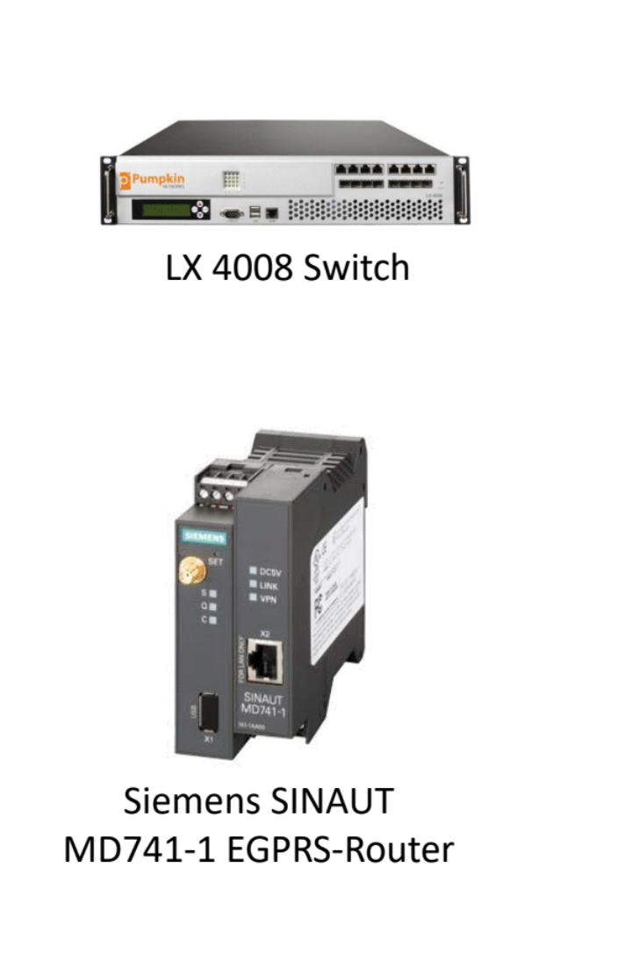
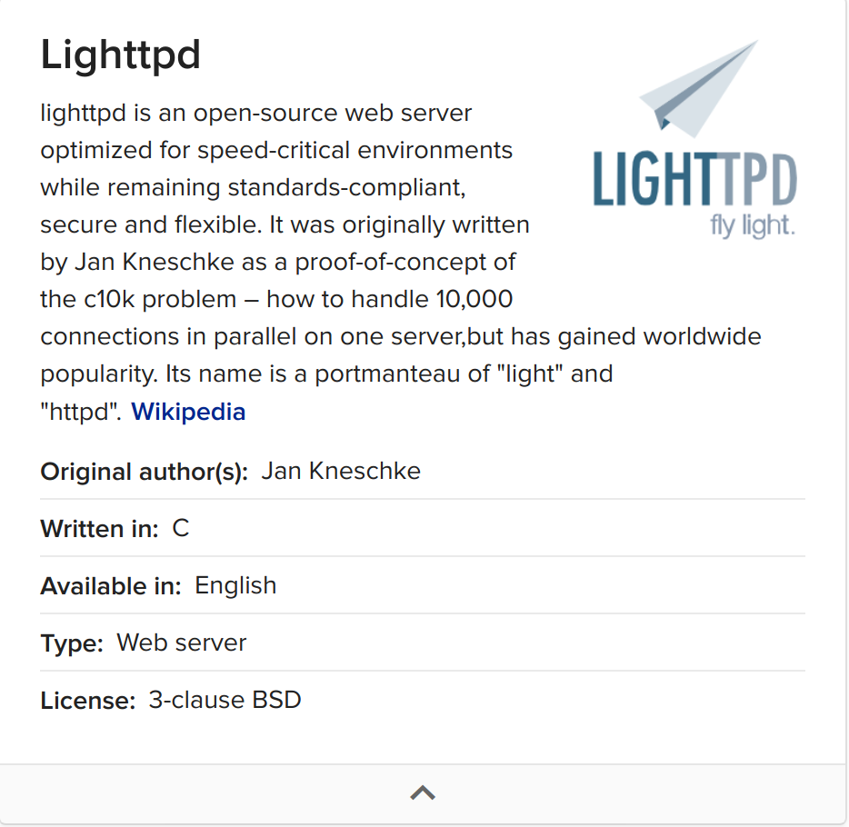
Lighttpd (“Lighty”)
Notes:
We’ll start with a real world example. Lighttpd is basically a lightweight webserver designed to run on speed-critical environments. Here’s a few examples of different devices that lighttpd can be found running on. Speed is important for routers handling high loads and numerous connections.

Slide 17
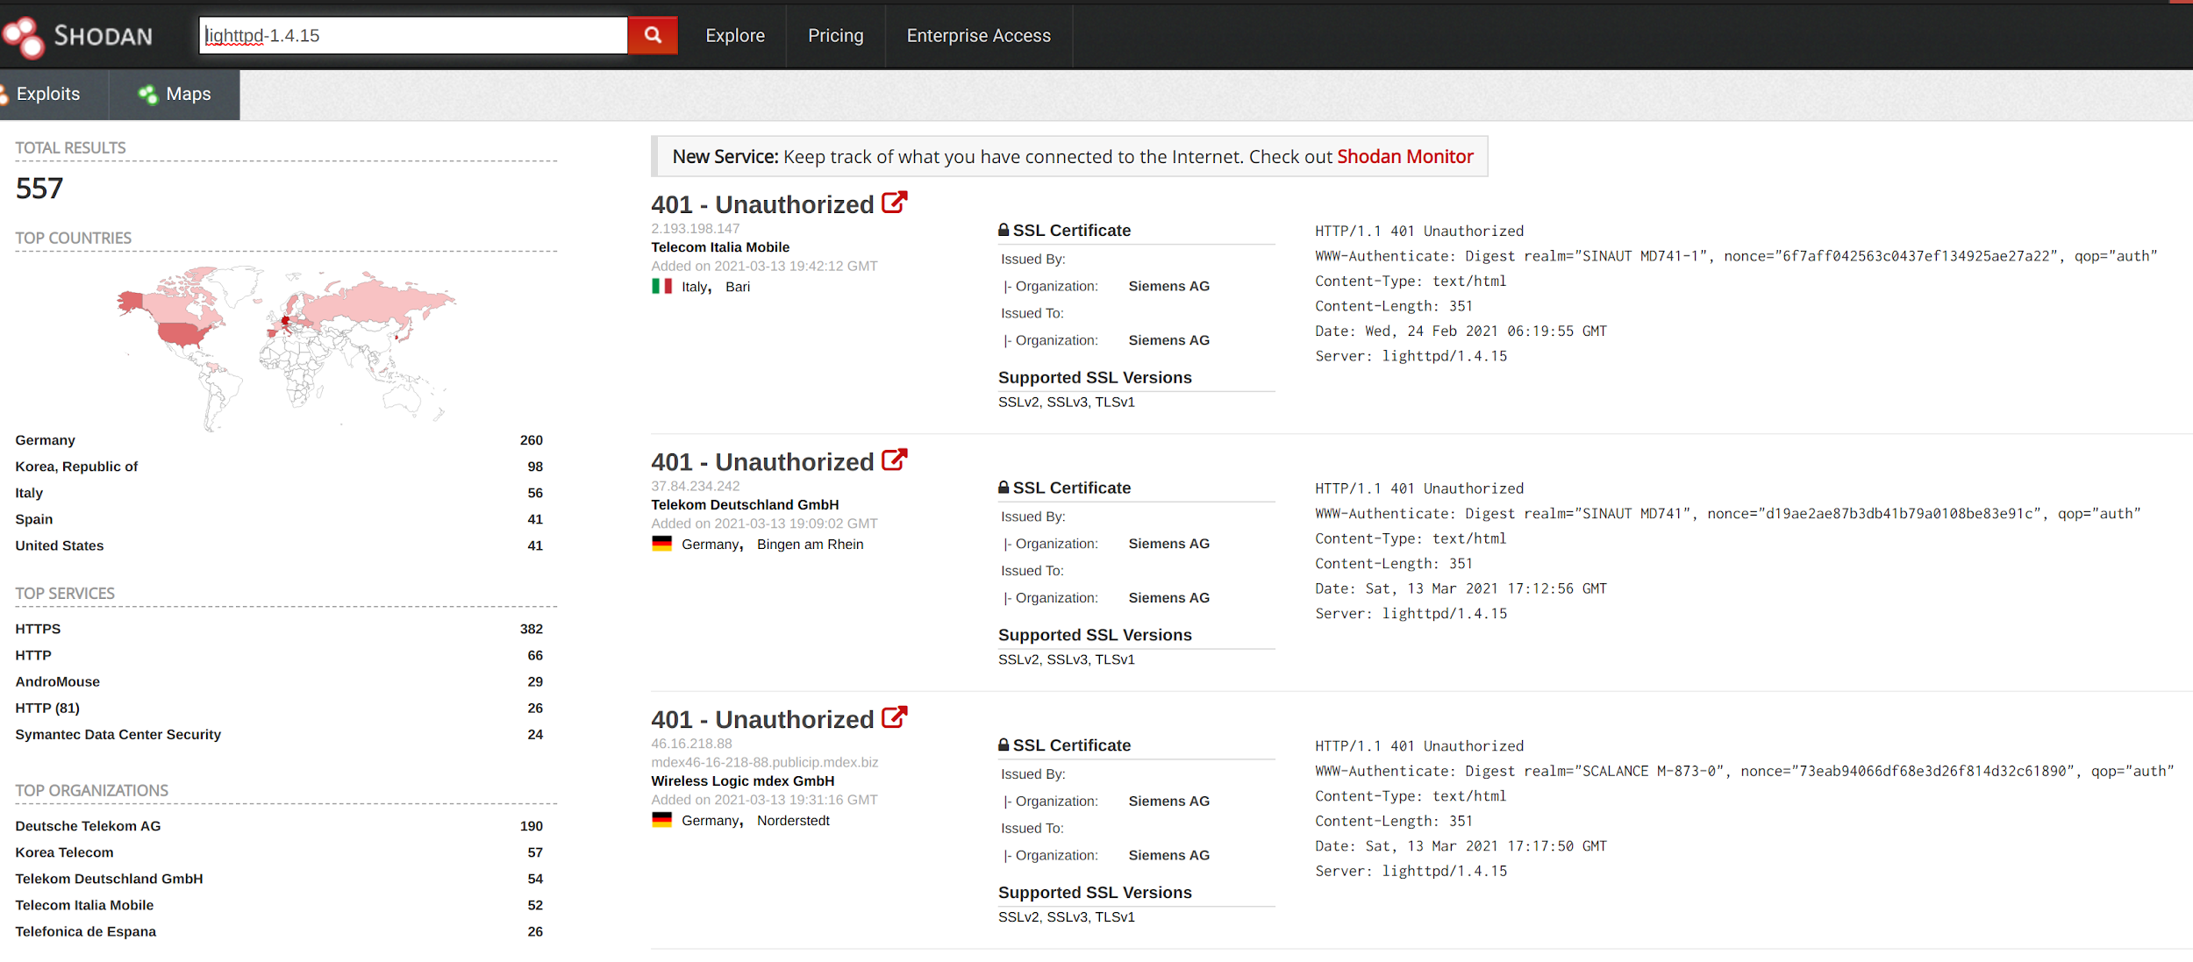
Lighttpd (“Lighty”)
Notes:
If we search for the version of Lighttpd that we’re going to test against on Shodan, we can see different internet-connected devices that advertise they are using this server. You can see the top services, (mainly webservers but in some cases we see Symantec), and we can also see which organizations are using this version of lighttpd, which is mostly telecoms.

Slide 18
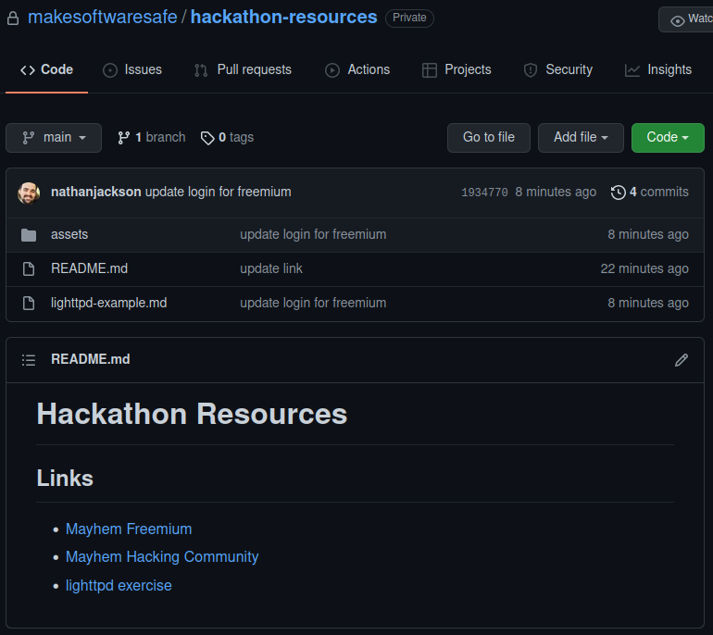
https://github.com/mayhemheroes/hackathon-resources
Go here
Click here
Notes:
Only UI

Slide 19
Quiz 1

Slide 20
What do fuzz testing and electricity have in common?
They both are measured in Ohms
They both have lightning to thank for leading to their discovery
They were both unsuccessfully patented in the U.S
Nothing!

Slide 21
Introduction to Fuzz Testing

Slide 22
Fuzzing / fəzing / v.
The process of automatically sampling and testing the program input space to elicit new program behaviors.
Fuzz testing is a technique appsec experts leverage.
Open Source software is everywhere. So let’s fuzz it before the bad guys do.
Notes:
Fuzz testing is the process of automatically sampling and testing the program input space to elicit new program behaviors.
Fuzz testing stands in contrast to other techniques like unit testing where you are testing known inputs and testing for expected results.
With fuzz testing, we send malformed inputs to applications with the objective of testing for anomalous behaviors, such as crashes, infinite loops, and memory leaks.
Why would you want to look for anomalous behaviors?
Anomalous program behaviors can indicate the presence of an underlying software vulnerability or reliability issue. In fact, hackers use fuzzing to find zero-day exploits that they can use to attack their victims.
Since fuzzing is a technique used by hackers to find vulnerabilities, all open source software should be fuzzed before the bad guys do it and find exploitable bugs.

Slide 23

Covering the Bases
“MOM” is ok()
“DAD” is ok()
“BOB” is ok()
“BAR” is ok()
“BAD” is vuln()!
Read (input)
If first char not ‘B’
If second char not ‘A’
If third char not ‘D’
ok()
vuln()
Notes:
Let’s first introduce the concept of fuzz testing with an example. Here we have a very simple program with a vulnerability represented visually as a graph structure.
At the right you can see the program’s behavior, where an unknown vulnerability lies at the bottom of a chain of conditional statements. At the left you can see a set of potential inputs. Each one of these inputs explores a particular path through the code.
Fuzz testing searches for vulnerabilities by exploring as many of the paths through a program as possible.
Start with “MOM”, feeding this to our program, the first check succeeds, so we see ok() behavior.
Next with “DAD”, again, the first check succeeds with a different input, so we see ok() behavior.
With the next two inputs BOB and BAR, we explore a couple more paths but ultimately end up executing the ok() behavior.
Finally, if we send “BAD” to our program, we fail every check so we end up executing the vulnerable code.

Slide 24
Simple Fuzzing Dataflow
Fuzzing Engine
Fuzz Target
Read (input)
Read (input)
“MOM” is ok()
“DAD” is ok()
“BOB” is ok()
“BAR” is ok()
“BAD” is vuln()!
If first char not ‘B’
If first char not ‘B’
If second char not ‘A’
If second char not ‘A’
If third char not ‘D’
If third char not ‘D’
vuln()
ok()
vuln()
ok()
Notes:
Now that you have an idea of what fuzzing is, let’s talk about the two major components of any fuzzing setup.
The fuzzing target, which is similar to a unit test. This is the code that exercises some functionality that we need to test in a codebase. In our simple example, the functionality is the tree of if-statements, but can be any code piece of code that you need to test.
A fuzzing engine generates and feeds test cases to the fuzzing target, all the while monitoring the target’s behavior to inform test case generation. The important thing to remember is that by monitoring the target they generate and mutate input data, either entirely on their own or by starting with a set of sample inputs.
Today we’ll be primarily be looking at fuzzing targets in open source software.

Slide 25
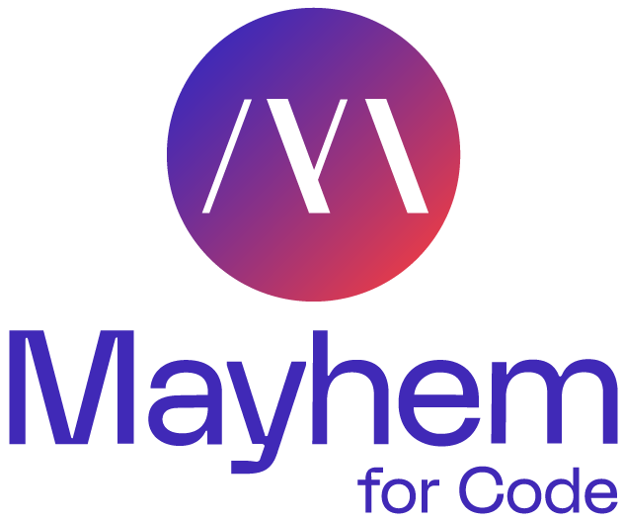
Simple Fuzzing Dataflow
Fuzzing Engine
Fuzz Target
Read (input)
Read (input)
$ ./myTarget
If first char not ‘B’
If first char not ‘B’
…?
If second char not ‘A’
If second char not ‘A’
If third char not ‘D’
If third char not ‘D’
vuln()
ok()
vuln()
ok()
Notes:
To put things concretely, Mayhem is a fuzzing engine; it autonomously builds up a test suite for your program by repeatedly exercising your fuzzing target and monitoring its behavior. A fuzzing target is a program that acts as a driver for executing the specific code you want to test.
A target can often be your application without changes if it accepts file or network inputs thanks to Mayhem’s ability to analyze binary only software. But like with any other type of testing, you as a developer may need to mock out dependencies or provide an interface that enables high-throughput, repeatable testing which is what we’re focused on today.

Slide 26
Example Fuzz Target
Input Vector
…
FILE *f = fopen(argv[1], “rb”)
…
fread(buf, 1, buf_size, f)
…
Entrypoint
int main(int argc, char **argv)
Candidate Function
fuzzme(buf);
Notes:
A target is a piece of code that exposes some functionality of your software under test to a fuzzing engine. A fuzzing target, at its simplest, should have 3 parts
First, you need to have an entrypoint that the fuzzing engine can execute.
As developers, you’re all already familiar with entrypoints: this is often the main function executed when you start your application.
In an fuzz target entrypoint, you can also execute any necessary setup code or transform the payload as necessary before delivering it to the code you want to test.
Next, you need to have an input vector, like a file.
The input vector is the way a fuzzing engine provides a fuzzed payload to your target.
File inputs are the most common, but network inputs are also possible.
If you’re re-using targets from open source in-memory fuzzers, Mayhem can also deliver inputs directly to the entrypoint’s arguments.
Finally, you have the candidate function.
This is the function, class, or module that you ultimately want to test.
Let’s put it together to see what this looks like in code.

Slide 27
Example Fuzz Target
#include <stdio.h>
#include <stdlib.h>
int fuzzme(char *buf)
{
if(strlen(buf) >= 3)
if(buf[0] == 'b')
if(buf[1] == 'u')
if(buf[2] == 'g') {
printf("You've got it!");
abort();
}
return 0;
}
int main(int argc, char **argv)
{
…
if (NULL == (f = fopen(argv[1], "rb"))) {
fprintf(stderr, "could not open file for fuzzing\n");
return 2;
}
if (!(sz = fread(buf, 1, sizeof(buf), f))) {
fprintf(stderr, "no data read from file\n");
return 3;
}
fuzzme(buf);
…
}
Input Vector
Entrypoint
Candidate Function
Notes:
The entrypoint is our main function which in this case accepts command-line arguments.
We read the payload from our input vector before finally passing it strtol, which is the functionality we want to test.
One thing I’ll point out here is that we don’t have any assertions or checks on the result of strtol.
Remember that the goal of fuzzing is to enumerate all behavior, including the anomalous ones like a crash or infinite loop .
In other words, we want to elicit bad behavior inside strtol. We aren’t necessarily checking for correctness with this target.
You can sometimes encode correctness into a target as well, which we’ll talk about shortly.

Slide 28
Example Fuzz Target
Input Vector
Fuzz Target
Entrypoint
#include <stdio.h>
#include <stdlib.h>
int fuzzme(char *buf)
{
if(strlen(buf) >= 3)
if(buf[0] == 'b')
if(buf[1] == 'u')
if(buf[2] == 'g') {
printf("You've got it!");
abort();
}
return 0;
}
int main(int argc, char **argv)
{
…
if (NULL == (f = fopen(argv[1], "rb"))) {
fprintf(stderr, "could not open file for fuzzing\n");
return 2;
}
if (!(sz = fread(buf, 1, sizeof(buf), f))) {
fprintf(stderr, "no data read from file\n");
return 3;
}
fuzzme(buf);
…
}
Fuzzing Engine
Candidate Function
./example_target @@
Notes:
Now let’s look at how Mayhem would interact with out fuzz target.
Mayhem first generates a file that contains a fuzzed payload.
Mayhem then invokes the target as if it were running on the command-line. During the invocation, it replaces “@@” with the path to the fuzzed payload.
The fuzz target reads the input file and passes it to strtol.
While the fuzz target is running, Mayhem is collecting data about the behavior of the target.
This process repeats infinitely until you stop it.
On each iteration, Mayhem is using the collected data to learn about how to create better payloads.
This strtol example is a simple example, but it is a real world example of how you would fuzz a library function.

Slide 29
Getting Help
Notes:
Before we dive deeper into he exercises, I’m going to show you how you get help with setting up targets.

Slide 30


ASU Hackathon Discord
Join us on Discord! You can message with questions, ideas, or anything you’d like: Invite Link: https://discord.gg/8dxuvcnB
Or, scan the QR Code with your phone:
Notes:
For today’s hackathon, we’ve setup a Discord server.
Go ahead and sign up now.
Remember, we won’t be monitoring the discord after today. For help after today, we’ll refer you to the community.

Slide 31
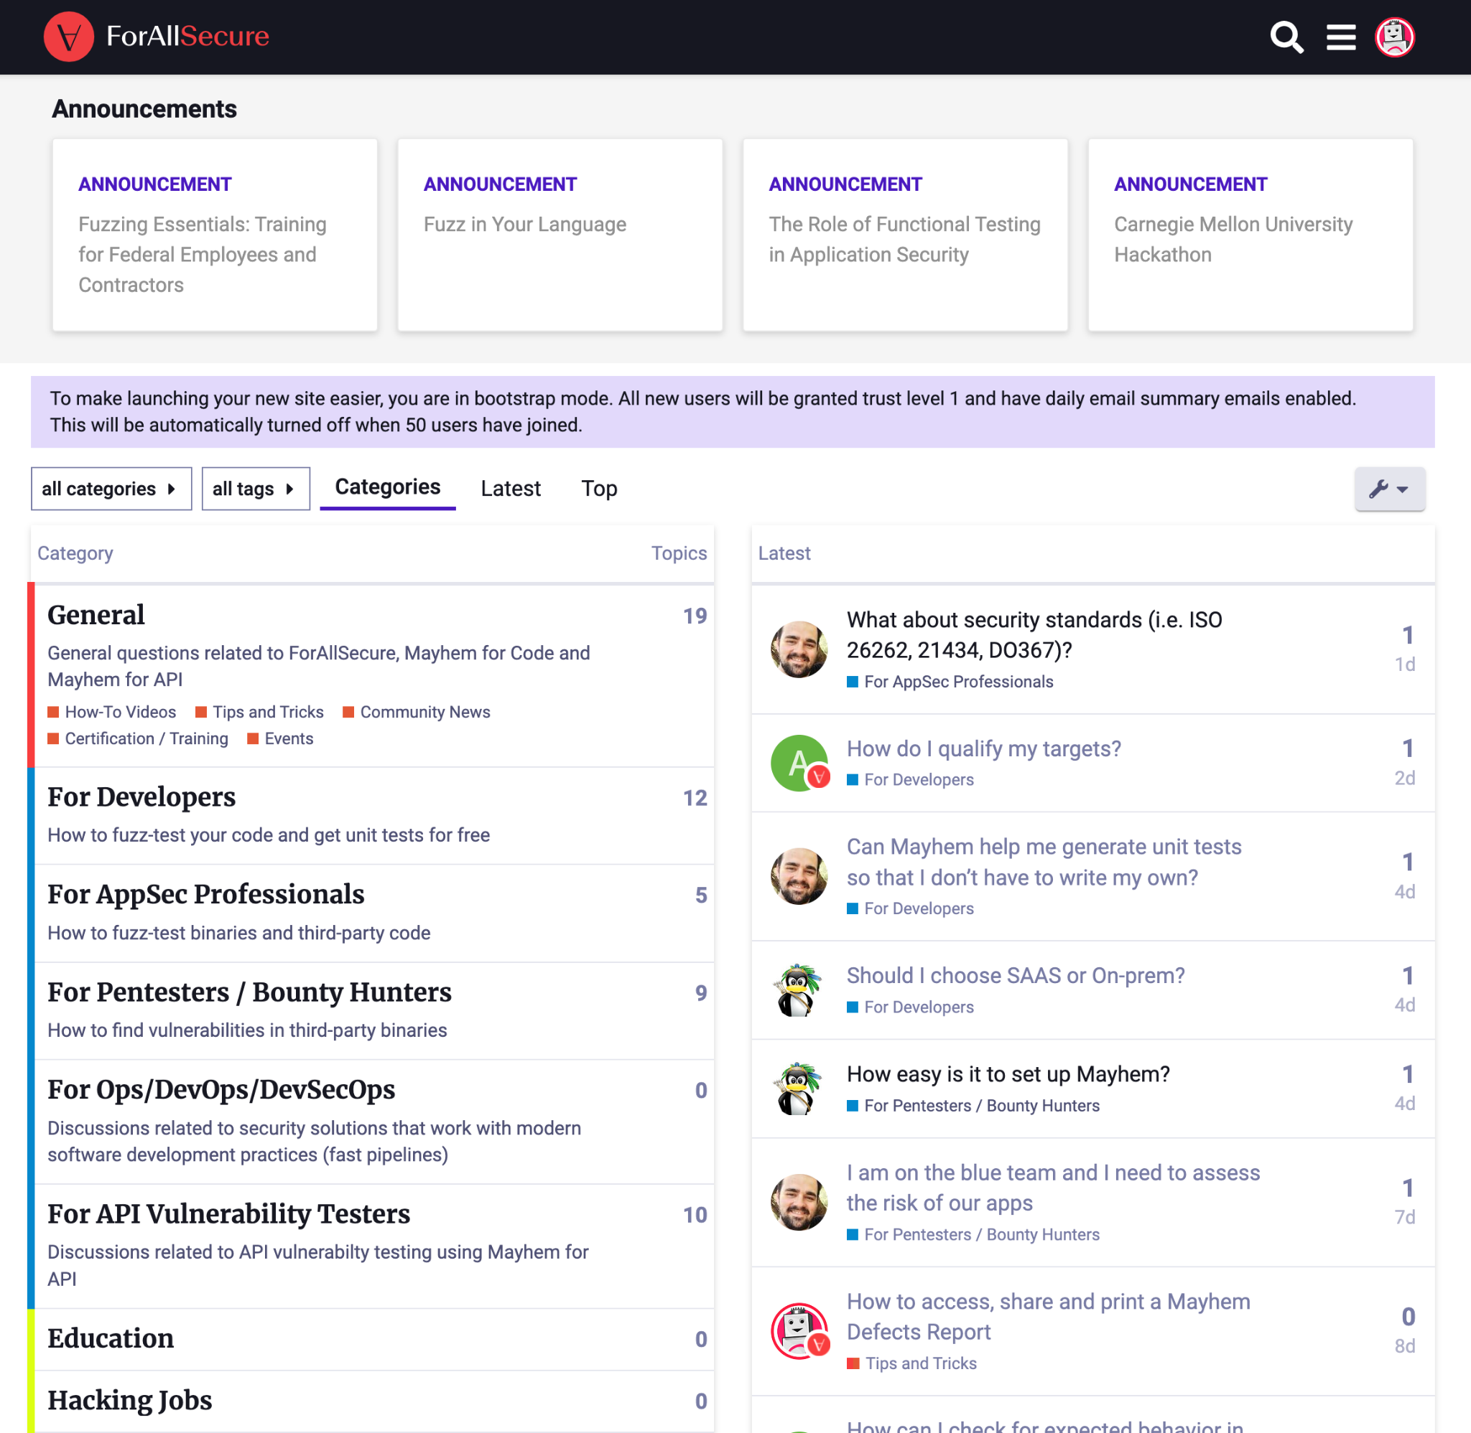
Get Help and Connect With Like-Minded People
Mayhem Hacking Community: community.forallsecure.com
Ask questions, get answers
How-to Tips and Tricks
Hacking articles and more
Hacking Jobs - coming soon
Notes:
Community is here to stay after the hackathon.
Here you can ask questions, view our how-tos, and learn best practices.
We’ll also be posting articles about hacking and hacking jobs.

Slide 32
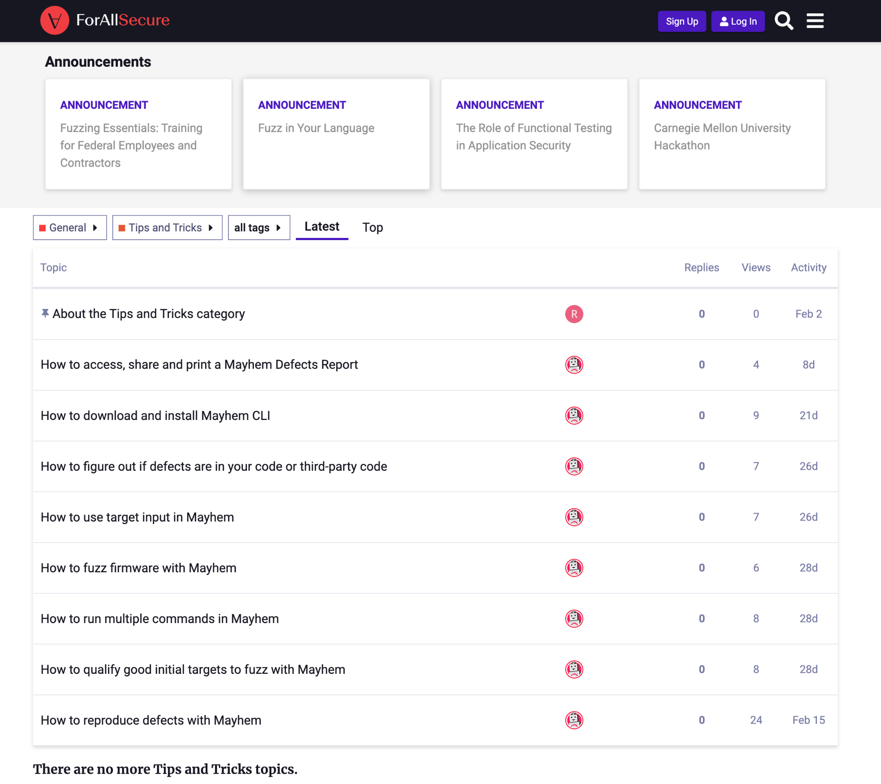
Sign Up to the Community
Navigate to community.forallsecure.com
Click Sign Up at the top of the page
Select “With Github”
Login to Github if not already logged in
You are now ready to explore the Community
Navigate to General > Tips and Tricks
Learn Mayhem Hacking Best Practices!
Notes:
Let’s take 5 minutes to sign up with the community.
Once you’re in, go ahead and view one of the Tips and Tricks.

Slide 33
Quiz 2

Slide 34
Fuzz Testing has found this many defects in Linux alone
110
1,100
11,000
110,000

Slide 35
Mayhem CLI
Notes:
Now, we’re going to talk about setting up the Mayhem command line interface. (Actually set it up?)

Slide 36
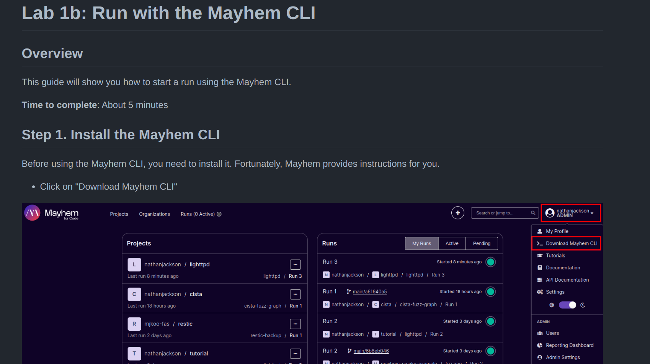
Lab 1b: Run with the Mayhem CLI
From lighttpd exercise, go to this section
Notes:
(walk through exercise)

Slide 37
Quiz 3

Slide 38
Fuzz Testing can help you find the following types of bugs:
Memory Leaks
Program Crashes
Buffer Overflows
Uncaught Exceptions

Slide 39
Packaging for Mayhem
Notes:
So now that you’re setup with Mayhem, let’s talk a little bit about how we setup lighttpd for you and how you can ingest your own targets into Mayhem.

Slide 40
What is
Fuzzing?
Fuzzing a target with Mayhem
1
Package a target using Docker
2
Set up build systems with CMake
3
Create a Fuzz Target (w/ libFuzzer)
4
Automate with Github Actions
5

Slide 41
Modern CI/CD Pipeline
Create a Fuzz Target with libFuzzer
Fuzzing a target with Mayhem
Set up regression testing
Package a target using Docker
Automate with Github Actions

Slide 42
Mayhem Target Requirements
Mayhem performs Dynamic Analysis
Runs a target, monitor its behavior. Requires dependencies to be present at runtime.
Mayhem is fuzzing, what happens when an input does something destructive?
Isolation Needed
Targets need to run the same way over and over.
Successful fuzzing depends on throughput (i.e., how fast can I run the target?)
Notes:
So Mayhem is performing a form of dynamic analysis against targets.
In other words, it runs your target, monitors the behavior. This necessarily means that any libraries or other dependencies need to be present.
Next since Mayhem is fuzzing, looking for anomalous behavior, we need to consider what happens if an input causes the program to do something destructive?
We definitely don’t want it take our host down.
So we need some form of isolation.
Targets also need to run the same way over and over. If there was any sort of non-determinism in the target or environment, fuzzing would ultimately take longer to penetrate deeper into the program.
Finally, successful fuzzing depends often on throughput. In other words, we need to run as fast as possible.

Slide 43
Process vs. Container vs. VMs
Everything isolated.
Isolates Address Space, Visible Processes
Isolates File System and Networks
Shared Hardware Resources
App 1
App 2
App N
Isolates Address Space
Shared File System, Network, Hardware Resources
Guest OS 1
Guest OS 2
Guest OS N
App 1
App 2
App N
App 1
App 2
App N
Container Runtime
Virtual HW 1
Virtual HW 2
Virtual HW N
Operating System
Operating System
Operating System\VM Manager
Hardware
Hardware
Hardware
Process Isolation
Container Isolation
VM Isolation

Slide 44
What is Docker? Why do we need it?
Mayhem accepts various types of packages, but the easiest to use is Docker images
Docker is the industry standard for Containers.
Not just for Mayhem!
Perfect for Mayhem’s use case!
We’ll go over building, distributing, and running containers.
App 1
App 2
App N
Docker
Container Runtime
Operating System
Hardware
Isolation from Host OS (without having to use virtualization)!
Notes:
We’ll be using Docker to package our fuzzing target today. Why Docker? Well, it’s one of the main types of packages Mayhem accepts, it creates a reproducible runtime environment for a target, and it’s easy to create, update and work with, and comes with a significant body of documentation.

Slide 45



Docker Basics
Dockerfile - Configuration as Code that describes how to build a Docker Image
$ docker build -t <image-name> .
This will build a Docker image based on the instructions in the Dockerfile
$ docker run <image-name>
This will run a container based off of the specified image
$ docker push or $ docker pull
Either uploads a local image to a registry or downloads an image from a registry
An Image is like a cake recipe. A container is like a cake!
image source: https://medium.com/platformer-blog/practical-guide-on-writing-a-dockerfile-for-your-application-89376f88b3b5

Slide 46
Docker + Mayhem Exercise

Slide 47
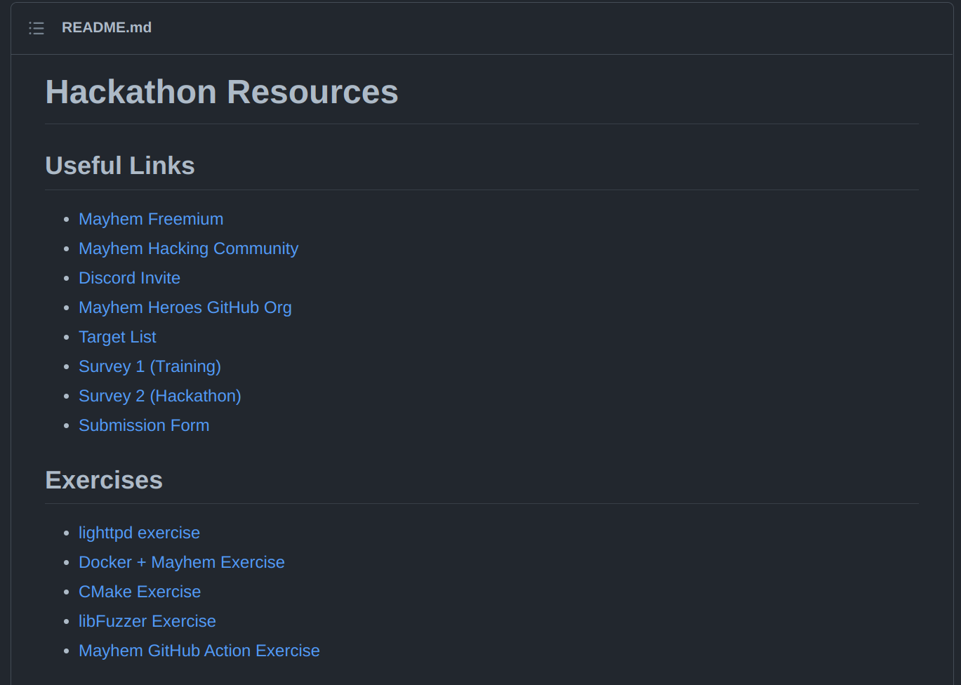
https://github.com/mayhemheroes/hackathon-resources
Go here
Click here
Notes:
(go through exercise)

Slide 48
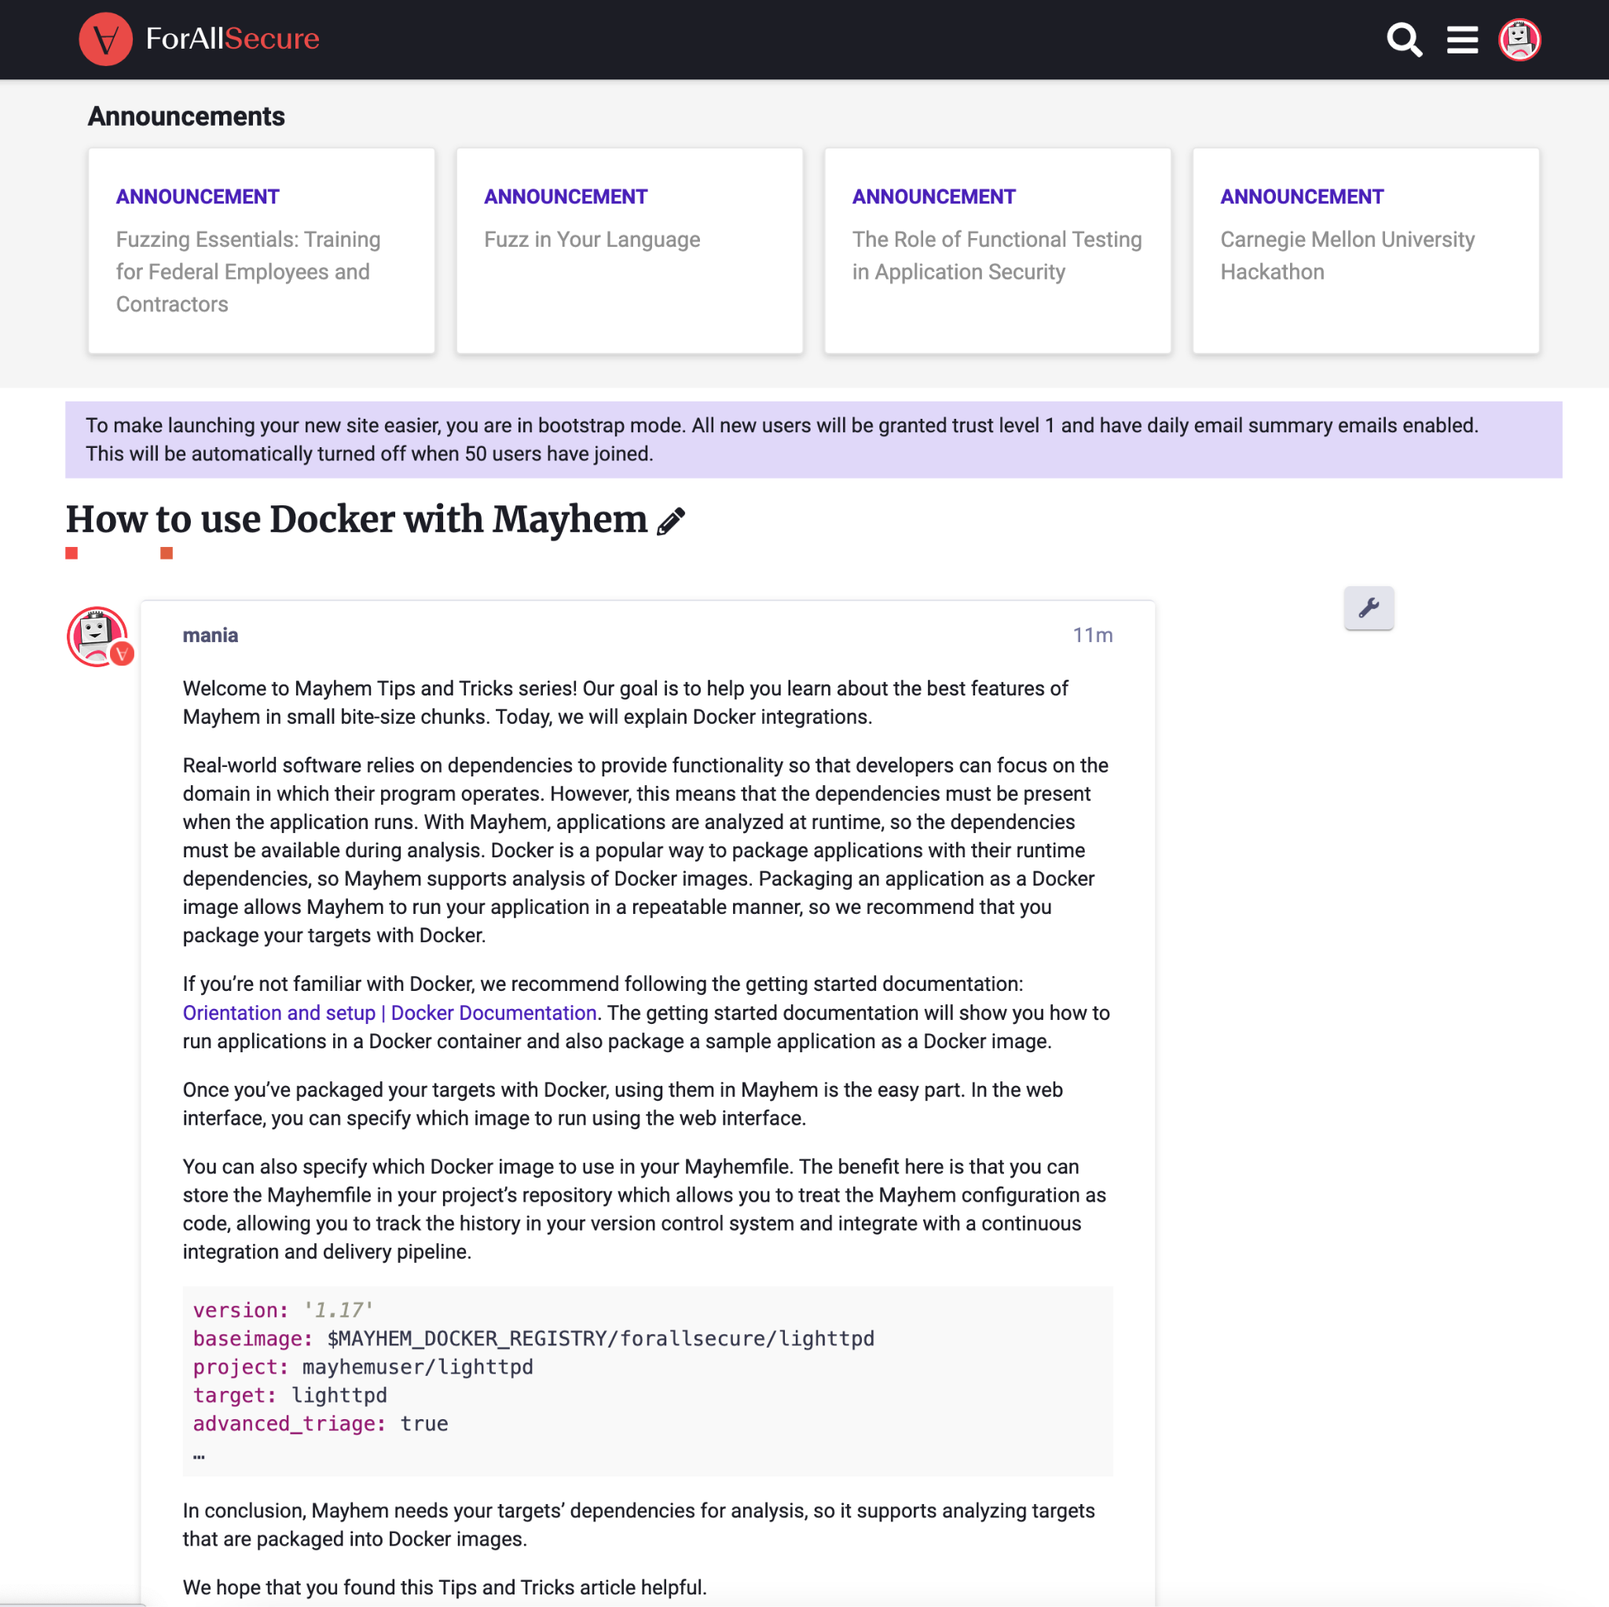
Docker Review
Pulled Image from Docker Hub and Created a Container
Built our own Docker image and pushed it into GitHub’s Registry.
Started a Mayhem Run that uses our new Docker image.
See the community Tips and Tricks, under General.

Slide 49
Quiz 4

Slide 50
Fuzz testing led to the discovery of one of the most critical vulnerabilities in the TLS protocol in the past decade, called:
Hungerstrike
Fullthrottle
Heartbleed
Tidalwave

Slide 51
Build Systems

Slide 52
What is
Fuzzing?
Fuzzing a target with Mayhem
1
Package a target using Docker
2
Set up build systems with CMake
3
Create a Fuzz Target (w/ libFuzzer)
4
Automate with Github Actions
5

Slide 53
Modern CI/CD Pipeline
Create a Fuzz Target with libFuzzer
Fuzzing a target with Mayhem
Set up regression testing
Package a target using Docker
Automate with Github Actions

Slide 54
Before we Begin: Build Systems
OSS and Industry use build systems to enable automation and repeatability of compilation steps.
Projects written in compiled languages need to be built before the code is run!
Running the compiler manually, IDE specific project files don’t automate well.
Notes:
Mention large shops have people dedicated to working out build systems.

Slide 55
Common Patterns with Build Systems
Configure Step - Generates configuration or other build system files.
Build Step - Use the build configuration from the previous step.

Slide 56
Identifying Build Systems
C, C++
autotools - look for a “configure” script.
CMake - look for a “CMakeLists.txt” file.
Rust - Uses Cargo
Look for “Cargo.toml”
Go - Uses “go” CLI.

Slide 57

CMake Example Usage
# Create directory for out-of-tree build.
$> mkdir build
# Change into build directory.
$> cd build/
# Generate Makefiles.
$> cmake ..
# Run make
$> make
Notes:
Mention that cmake is the most popular c, c++ build system

Slide 58
CMake Exercise

Slide 59
https://github.com/mayhemheroes/hackathon-resources
Go here
Click here
Notes:
(go through exercise)

Slide 60
CMake Review
Generated Build Files with cmake.
Used make to perform build.
Ran an executable generated by a CMake build system.
Pattern:
Generate Build Files\Configure Step
Build Step (usually Make)
Notes:
Only show CMake, stop before libFuzzer!

Slide 61
Quiz 5

Slide 62
Which of the following tools is NOT an open source fuzzing utility?
American Fuzzy Lop (AFL)
Wasp
libFuzzer
Honggfuzz

Slide 63
OSS Fuzzers

Slide 64
Mayhem + OSS Fuzzers
Not only does Mayhem support binary only analysis, but it also analyzes targets built with open source fuzzing technology.
AFL
Compile-time instrumentation with GCC/Clang (source required)
Works with programs that accept network of file input.
libFuzzer
Compile-time instrumentation with Clang (clang -fsanitize=fuzzer)
In-memory fuzzer (it runs really, really fast)
go fuzz, cargo fuzz
Open source fuzzers for Go and Rust - built into the language!
Many of the repositories in the hackathon already have fuzzing targets. Bootstrap them in Mayhem!

Slide 65
libFuzzer
Popular framework in Open Source and Industry for fuzzing.
Part of the LLVM Project, requires clang\clang++.
Requires the creation of a special function called: LLVMFuzzerTestOneInput
Typically used with Address Sanitizer to find memory corruption bugs.
clang -fsanitize=address,fuzzer
Vast majority of targets already have libFuzzer targets.

Slide 66
Example libFuzzer Target
Input Vector
#include <stdint.h>
#include <stdlib.h>
int fuzzme(char *buf)
{
if(strlen(buf) >= 3)
if(buf[0] == 'b')
if(buf[1] == 'u')
if(buf[2] == 'g') {
printf("You've got it!");
abort();
}
return 0;
}
int LLVMFuzzerTestOneInput(char* data, size_t len)
{
fuzzme(data);
return 0;
}
Entrypoint
Candidate Function
$> clang -fsanitize=fuzzer -c example_target.c
$> clang -fsanitize=fuzzer example_target.o -o example_target
$> ./example_target
INFO: Seed: 705835306
INFO: Loaded 1 modules (1 inline 8-bit counters): 1 [0x4e8040, 0x4e8041),
INFO: Loaded 1 PC tables (1 PCs): 1 [0x4be930,0x4be940),
INFO: -max_len is not provided; libFuzzer will not generate inputs larger than 4096 bytes
INFO: A corpus is not provided, starting from an empty corpus
#2 INITED cov: 1 ft: 1 corp: 1/1b exec/s: 0 rss: 23Mb
#8388608 pulse cov: 1 ft: 1 corp: 1/1b lim: 4096 exec/s: 4194304 rss: 23Mb
#16777216 pulse cov: 1 ft: 1 corp: 1/1b lim: 4096 exec/s: 4194304 rss: 23Mb
Notes:
The entrypoint is our main function which in this case accepts command-line arguments.
We read the payload from our input vector before finally passing it strtol, which is the functionality we want to test.
One thing I’ll point out here is that we don’t have any assertions or checks on the result of strtol.
Remember that the goal of fuzzing is to enumerate all behavior, including the anomalous ones like a crash or infinite loop .
In other words, we want to elicit bad behavior inside strtol. We aren’t necessarily checking for correctness with this target.
You can sometimes encode correctness into a target as well, which we’ll talk about shortly.

Slide 67
libFuzzer Exercise

Slide 68
https://github.com/mayhemheroes/hackathon-resources
Go here
Click here
Notes:
(go through exercise)

Slide 69
libFuzzer Review
Created a libFuzzer target that tests a function “fuzzme”.
Updated our CMake build system to handle a libFuzzer target.

Slide 70
Quiz 6

Slide 71
Who named fuzzing?
Barton Miller
David Brumley
Hanno Böck
Alex Brewer

Slide 72
Contributing to OSS

Slide 73
What is
Fuzzing?
Fuzzing a target with Mayhem
1
Package a target using Docker
2
Set up build systems with CMake
3
Create a Fuzz Target (w/ libFuzzer)
4
Automate with Github Actions
5

Slide 74
Modern CI/CD Pipeline
Create a Fuzz Target with libFuzzer
Fuzzing a target with Mayhem
Set up regression testing
Package a target using Docker
Automate with Github Actions

Slide 75

What is GitHub? Why does the Industry use it?
Hosts Git repositories many open source projects.
More than just a code repository.
Organizations
Issue Tracking
Continuous Integration (GitHub actions).
Our objective: scale up fuzzing across popular projects hosted on GitHub!
Open Source projects are part of the supply chain for everyday products and services.

Slide 76

Contributing to OSS on GitHub
OSS Developers store their work-in-progress code on “fork” repositories.
Forks are copies of repos owned by someone other than the original developer or organization.
Once a contributor has finished their changes, they submit a pull request to the original project.
Once approved, the changes are incorporated back into the project.

Slide 77

Continuous Integration\Delivery
Open and closed source development projects usually have a test suite to ensure the software behaves as intended.
CI\CD usually runs the test suites automatically whenever a developer pushes to a project.
Helps to maintain software quality and takes some of the monotony out of certain developer workflows.

Slide 78
Continuous Integration\Delivery
GitHub Actions are workflows that run in response to project events (e.g., push to a repository, pull requests, etc).
GitHub Actions can integrate with other tools, like Mayhem!
Now, let’s work through setting up CI/CD for our example CMake project.

Slide 79
GitHub Action Exercise

Slide 80
https://github.com/mayhemheroes/hackathon-resources
Go here
Click here
Notes:
(go through exercise)

Slide 81
GitHub Actions Review
Created a workflow that runs in response to push events.
Automatically built a target
Automatically started fuzzing run against target.

Slide 82
Quiz 7

Slide 83
Which of the following techniques are not used as part of Fuzz Testing
Binary Analysis
Reverse Engineering
Regression Testing
Virus Signature Scanning

Slide 84
Case Study: cista
Notes:
https://github.com/mayhemheroes/cista

Slide 85
Conclusions

Slide 86
Now What?
We’ve worked through setting up Mayhem, CMake, OSS Fuzzers, and GitHub Actions.
There are a lot of topics not covered here that might apply to specific targets. Google is your friend!
If in doubt, ask in the community.

Slide 87
Training Survey
Please take our training survey!
< 5 minutes.
https://dydbdnwi0qu.typeform.com/to/jZEKf0it
Also in the hackathon-resources repo under useful links (Survey 1)
Notes:
Switch to welcome deck for raffle!

Slide 88
Mayhem Heroes
Notes:
Transition

Slide 89
Modern CI/CD Pipeline
Create a Fuzz Target with libFuzzer
Fuzzing a target with Mayhem
Set up regression testing
Package a target using Docker
Automate with Github Actions

Slide 90
Secure the World’s Software
Our goal is to make the world’s software safe.
OSS is used everywhere, so we should be analyzing it before it makes it into production systems.
Mayhem Heroes Bounty: Up to $1000 for each integration!
Each integration will ultimately end up here: github.com/mayhemheroes

Slide 91
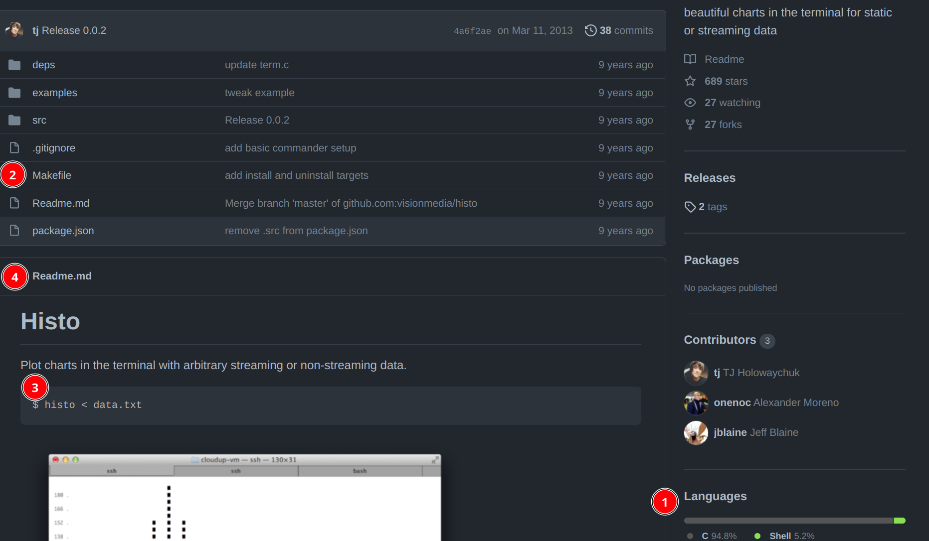
What do I look for in a target?
Language
Build System
Target Binary (if any)
README.md!

Slide 92
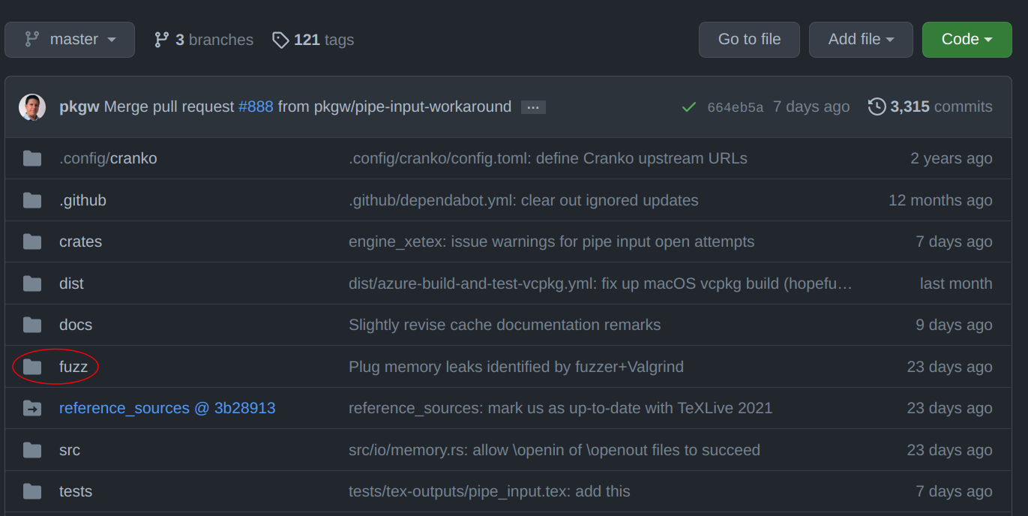
If it has a “fuzz/” folder…
Great! This should be easy. Integrate Mayhem with the existing fuzz target(s) underneath the fuzz/ folder

Slide 93
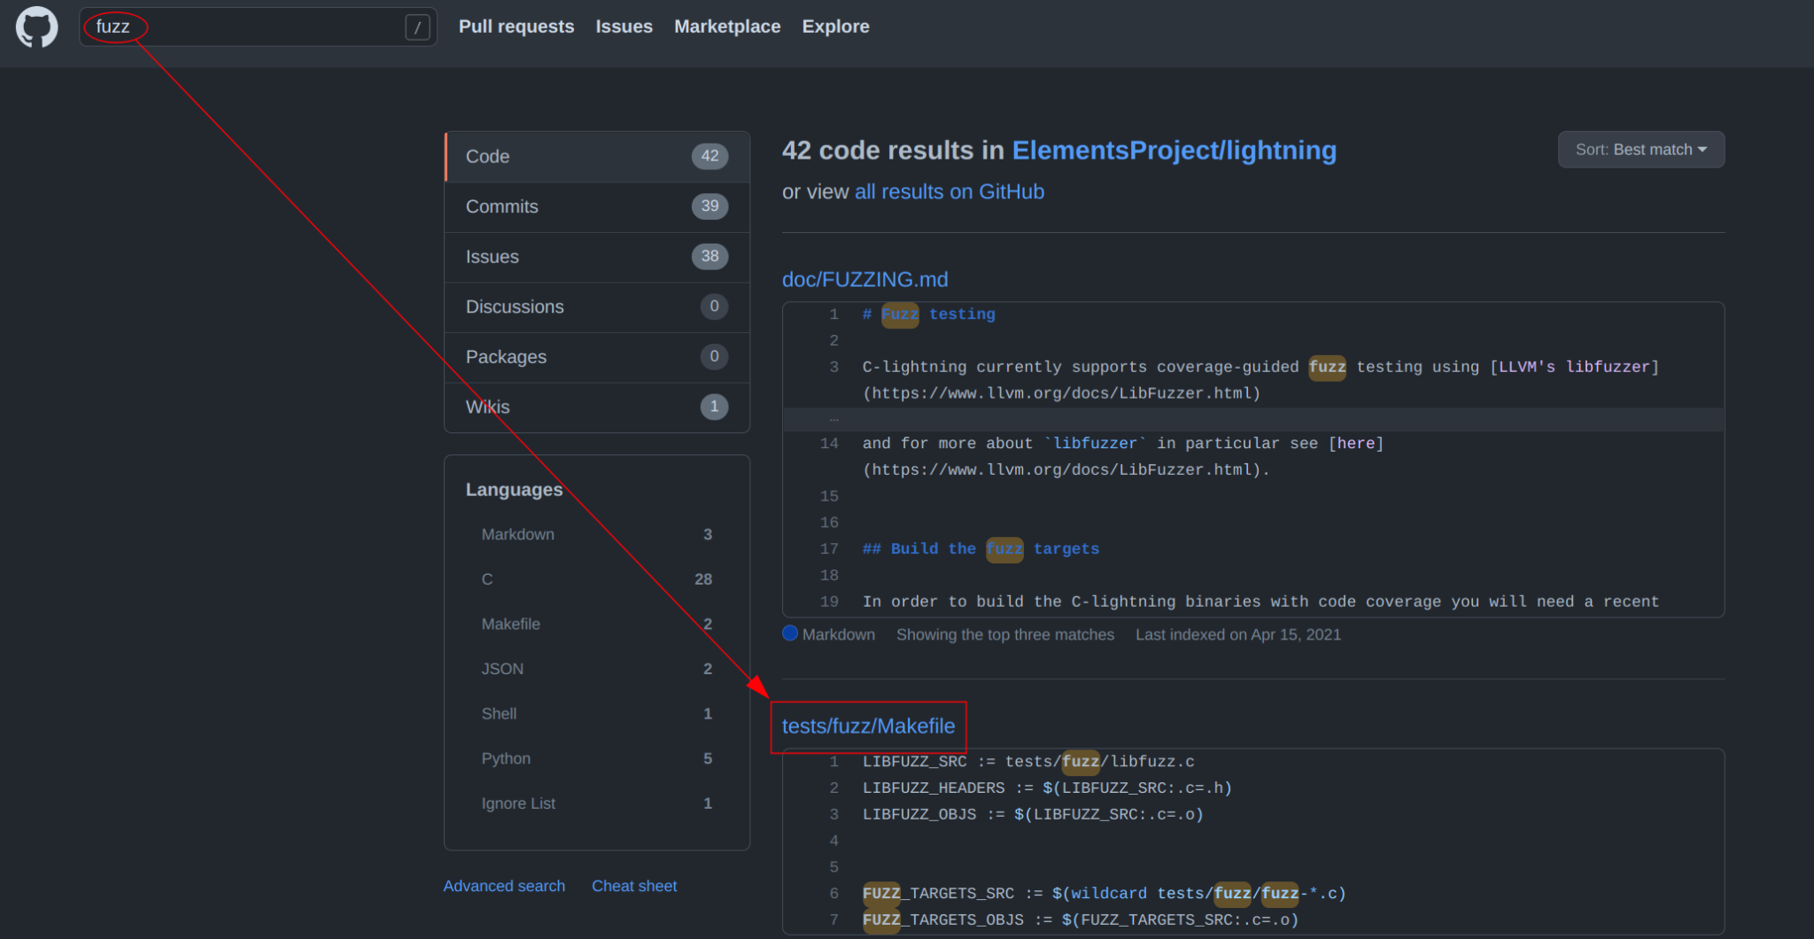
If it has a “fuzz/” folder…
Great! This should be easy. Integrate Mayhem with the existing fuzz target(s) underneath the fuzz/ folder
Hint: It might not be in the top level directory! Try searching for the word “fuzz”...

Slide 94
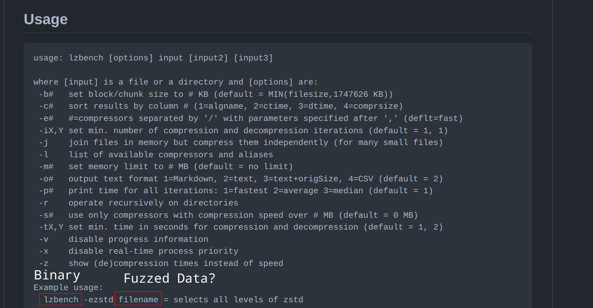
If it has a target binary that takes input
Via STDIN or a File
Also great! You should be able to send fuzzed data to the binary directly!

Slide 95
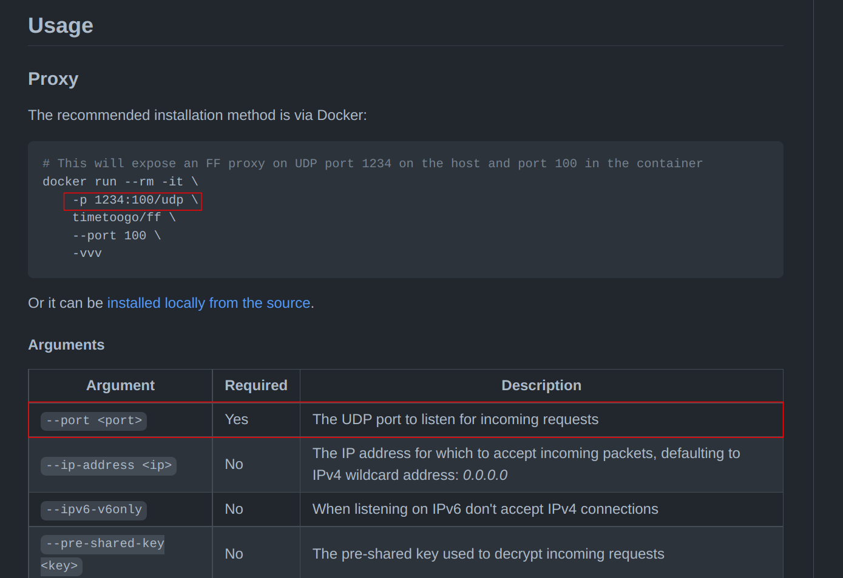
If it has a target binary that opens a port…
Via TCP/UDP
This is just like lighttpd! You should be able to send fuzzed data to the network port

Slide 96
If all else fails
You might need to develop the fuzz target yourself.
Look for a tests/ folder. You can usually leverage this code to create a fuzz target!
Read the README.md! It usually has all of the information you need to understand the repository
Ask for help!

Slide 97
Mayhem Heroes Workflow
Select a target repository for integration.
Project must not be part of OSS Fuzz (check the GitHub Repo before working: https://github.com/google/oss-fuzz/tree/master/projects)
Project must be hosted primarily on GitHub, no mirrors at this time.
100+ stars
We have a list of curated projects as well.
Targets must be part of the first-party code

Slide 98
Claim your Target Now
https://docs.google.com/spreadsheets/d/1cFwb9ZQMGRrZk8NxaGYX54Qdk3rN53ZW1k3SA36jyR8/edit?usp=sharing
Also in hackathon-resources.
Put your name in the column - 5 minutes.
Notes:
5 minutes to

Slide 99
Mayhem Heroes Workflow
Create a Fork of the Repository on GitHub
Get Mayhem to run with your target (place a blue sticker on your laptop lid)
Integrate Mayhem into your Fork
Submit this form (also in Hackathon resources): https://dydbdnwi0qu.typeform.com/to/l6MK0WJp
ForAllSecure will validate your target and eligibility. Assuming there are no issues with the target or your eligibility, you’ll be asked to submit a pull request on GitHub.
Once your changes have been approved in the pull request, you’re eligible for $750!
We may request additional changes. You can’t really “fail”, we want everyone to be successful and will point you in the right direction during the review process.

Slide 100
Mayhem Heroes Workflow
Monitor the Mayhem integration under github.com/makesoftwaresafe. If the integration breaks, you’ll need to update your fork and submit a new PR.
If after, 30 days your integration still works, now you’re eligible for $250!

Slide 101
questions?

Slide 102
Hackathon Survey
Please take our hackathon survey!
< 5 minutes.
https://dydbdnwi0qu.typeform.com/to/gyUrPXDM
Also in the hackathon-resources repo under useful links (Survey 2)

Slide 103
thank you

Slide 105
Make
Common build automation tool on Unix-like systems.
Makefile
Domain-specific language that describes how to build the executables, libraries, and object files.
Modern C, C++ projects often need advanced features that Make doesn’t provide, so they use build systems that generate Makefiles.

Slide 106
CMake
CMake is one of the build systems used by modern C or C++ projects.
CMake itself is a domain-specific language.
“Batteries included” - provides sensible defaults for C, C++.
Generally easier to use than Make alone.
Generates Makefiles or IDE specific project files.
Generally easier to use than Make by itself.

Slide 107
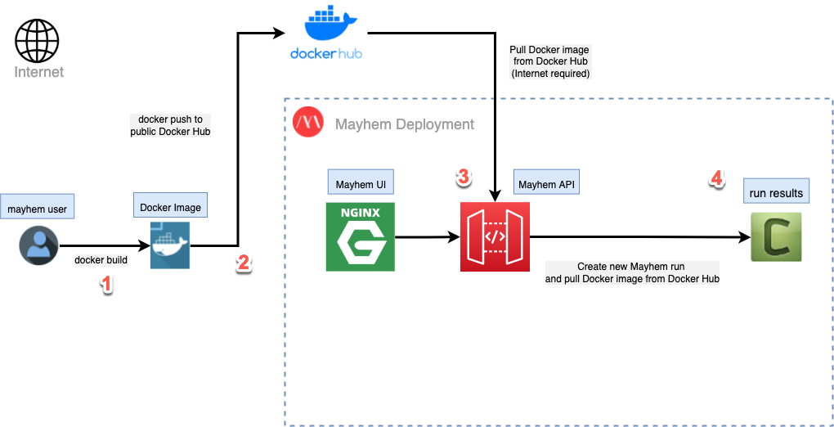
Mayhem + Docker Workflow

Slide 108
Building Docker Images
The instructions to build a Docker image are in a “Dockerfile”.
Images are tagged an image name and version, usually in the form of. <Organization>/<Project>:<Version>
“docker build …” is used to build an image.
# Stage 1: Setup build environment:
FROM ubuntu:20.04 as builder
RUN apt-get update && apt-get install -y gcc
ADD fuzzme.c /
RUN gcc fuzzme.c -o fuzzme
# Stage 2: Create final image.
FROM ubuntu:20.04
COPY --from=builder /fuzzme /

Slide 109
Solution: Containers!
Run our targets in an isolated manner that also enables fast, repeatable testing.
Package executables and with their dependencies.
Mayhem needs access to both the executable and any dependencies to run the program.
Isolate programs
Need to prevent a misbehaving application from affecting the host.
Launching and tearing down a VM is slow, even with snapshots.
Run an application the same way across multiple machines.
Results need to be easily reproducible.
Need to prevent: “it works on my machine”.
Notes:
So in industry, we have a solution for this already. To achieve all of our packaging requirements, we can place our target in a container.
Containers will let us run targets in an isolated manner while enabling fast, repeatable testing.
A container contains the executable and any dependencies, which Mayhem needs to run the target.
Containers also provide an extra layer of isolation that prevents the a misbehaving program from affecting the host. At the same time, containers are also much more lightweight than something like a virtual machine, so they don’t take a long time to startup or teardown.
Finally, we need to be able to run an application the same way across multiple machines.

